Slide 1
NON-ATHEROSCLEROTIC CAUSES OF CAD
Dr Ajay Nair
Senior Resident
Department of Cardiology
Calicut Medical College

Slide 2
Introduction
Approximately 4% to 7% of all patients with acute MI and nearly four times this percentage of patients younger than 35 do not have atherosclerotic CAD on CAG or Necropsy.

Slide 3
Cong. Anomalies
Spont. Recanalizn
Supply-demand mismatch

Slide 5
Various non atherosclerotic mechanisms of CAD are:
Internal narrowing
External narrowing
Both
Spasm
Demand supply mismatch

Slide 6
Congenital Coronary Anomalies
Seen in 1% to 5% of patients undergoing CAG
Split RCA>Ectopic RCA( Right Cusp) >Ectopic RCA(Left Cusp)>Coronary Fistulas

Slide 7
Ischemia Occurring in congenital anomalies
Type of Ischemia | Coronary Anomaly
Absence of Ischemia | Most anomalies (Split RCA, Ectopic RCA from right cusp, Ectopic RCA from left cusp)
Episodic Ischemia | Anomalous origin of a coronary artery from the opposite sinus(ACAOS); Coronary fistulas; Myocardial bridge
Obligatory Ischemia | ALCAPA ; Coronary ostial atresia or severe stenosis

Slide 8
Origin of Left and Right coronaries from the same sinus of valsalva (ACAOS)
The anomalous vessel can traverses the base of the heart in a course
1. Anterior to pulmonary trunk
or
2. Posterior to aorta
or
3. Between the aorta and pulmonary trunk

Slide 10
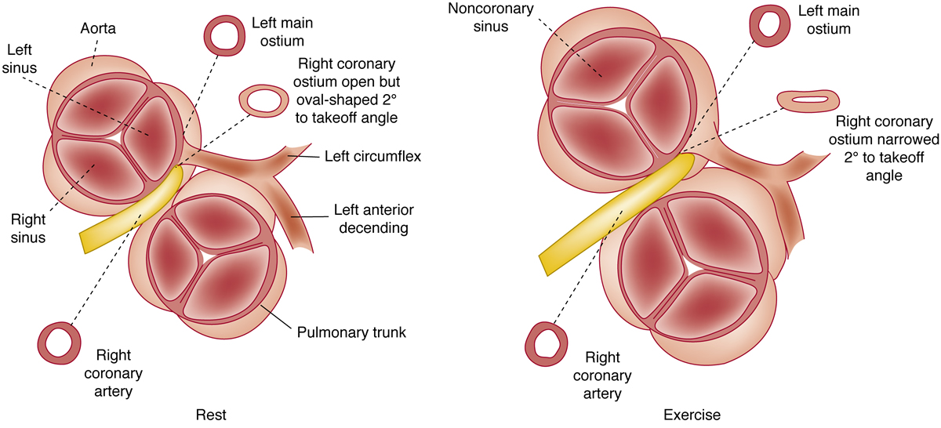
The mechanism of ischemia, infarction, and or sudden death:
Abnormal slit like coronary ostium of the anomalous vessel. ( Due to acute angle of take off)

Slide 12
True mechanical compression of the anomalous coronary artery between the Great vessels is not the mechanism of ischemia.
( Hurst’s )

Slide 13
Braunwald’s:
Mechanism of SCD:
-Slit like ostium
-A bend with acute angle take off
-Mechanical compression

Slide 14
Treatment
CABG
Coronary Stenting: Acceptable medium term success.

Slide 15
Single coronary artery
Rare in the absence of other anomalies of the heart
One or more branches of the single artery may cross the base of the heart in previously mentioned fashion with risk of ischemia due to acute angulation.

Slide 17
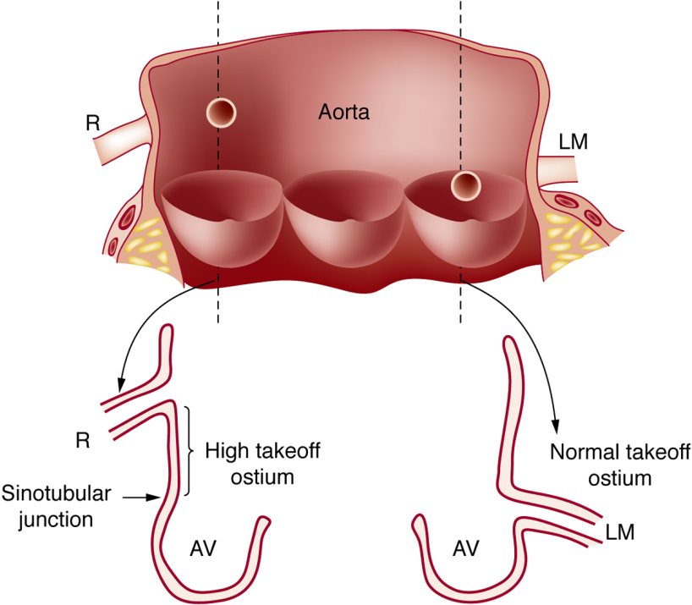
High take off coronary ostia
Normal coronary ostia- Within the sinus of valsalva
“High takeoff” coronary ostia: In the tubular portion of aorta.

Slide 18
? Significance
Variably classified as benign and dangerous in different series.
Often associated with other coronary anomalies like origin from the opposite coronary sinus.

Slide 19
Ostial fibrous ridges

Slide 20
Non-atherosclerotic causes of coronary ostial narrowing include:
Syphilis
Takayasu disease
Fibrobromuscular hyperplasia (Drug induced)
Aortic valve surgery
Protruding masses:-Calcific Nodules
-Supravalvular AS
-Aortic Dissection
-Adhesion of Ao cusp to sinus
-Embolism
-Fibroelastosis

Slide 21
Rarer associations of congenital coronary stenosis
Homocystinuria
Friedrich’s Ataxia
Hurler Syndrome
Rubella Syndrome
Progeria

Slide 22
Anomalous origin of coronary artery from Pulmonary Artery
Myocardial ischemia and infarction in infants
> 90% - LMCA is the anomalous artery
95% untreated patients die within the first year
Asymptomatic older patients can present with:- - - -An abnormal ECG
- A systolic murmur
- Sudden death
Papillary muscle dysfn
Or
Myocardial wall damage

Slide 24
Myocardial Bridges (“Tunneled” Epicardial Coronary Artery)

Slide 25
Incidence- 5 to 12%
Usually confined to LAD territory
Mostly hemodynamically insignificant

Slide 26
Factors determining risk of ischemia

Slide 28
Management
CCB - Control tachycardia
Beta-Blockers - Anti spasmodic effect
Avoid Nitrates
Surgery- Supra arterial myotomy Mixed
Stenting Results

Slide 29
Coronary Artery Fistula
Abnormal communication between a coronary artery and a –
Cardiac chamber ( Mostly RA and RV)
Major vessel (vena cava,
sub-pulmonary veins, pulmonary artery)
Other vascular structures ( Mediastinal vessels, Coronary sinus)

Slide 30
Prevalence- 0.1%
Most important hemodynamically significant coronary artery anomaly.
RCA>LCA
Presentation:-
Incidental finding
Continuous murmur
Angina/Acute MI/SCD/Coronary Steal/CCF/Stroke/ I.E / Arrhythmias/Coronary Aneurysms

Slide 31
Management
Surgery
Transcatheter embolization

Slide 32
Coronary Aneurysm
Cong. Aneurysms- Most common in RCA
- Least common in LMCA
Abnormal flow patterns result in:-
Thrombus formation
Subsequent vessel occlusion
Distal thromboembolism
MI

Slide 33
Coronary aneurysms can be:
Congenital
A sequelae to: -Atherosclerosis
-Trauma
-Angioplasty
-Atherectomy
-Laser procedures
-Arteritis
-Kawasaki disease
-Takayasu
-SLE
-Dissection
-Marfan Syndrome

Slide 34
Coronary Artery Embolism
Predisposing conditions:
Left sided prosthetic valve
Active I.E
Native left sided valve stenosis
A.F
L.V Aneurysm/Thrombus
DCM
Cardiac tumor
Cardiac catheterization or cardiac surgery

Slide 36
Most commonly involves LAD
Can be the cause for angiographically normal coronaries following an acute MI.

Slide 37
CORONARY ARTERY DISSECTION
Primary or Secondary
Primary: Spontaneous
Iatrogenic or Traumatic
Secondary:-More common
-Mostly an extension from aortic root dissection

Slide 38
Spontaneous Coronary Artery dissection:
Mostly in post partum women
May be associated with coronary artery wall . eosinophils
LAD mostly affected
SHT is not a major risk factor
Lysyl oxidase deficiency is a major risk factor
Can result in SCD or Acute MI.
Can become chronic leading on to CCF

Slide 40
Therapeutic dissection:
Localized and limited coronary artery dissection is necessary for a succesful balloon angioplasty.
Differentiating from dissection occurring as a complication of angioplasty:
1. Short axis image : Dissection involving>50% of coronary media circumference.
2. Long axis image: Dissections longer than 1cm
Spiral dissection: Most serious dissection injury after angioplasty

Slide 41
Coronary Artery Spasm
Initially described by Prinzmetal et al in 1959
Specific pathogenesis is unknown
Spasm is not induced by usual factors:
Exercise
Emotional Upset
Cold
Ingestion of meal
Induced by:
Cigarette Smoking
Cocaine use
Alcohol
Catecholamine

Slide 42
Enhanced alpha adrenergic tone and various vasoactive substances such as Histamine, Catecholamine, Prostaglandins and Thromboxane are possibly involved.
ECG changes revert rapidly, spontaneously or with NTG.
Spasm may be accompanied by A.V Block,V.T or V.F.
M.I and death are rare
May be superimposed on myocardial bridging.

Slide 43
Histological sections ---luminal concentric plaques that had a predominance of smooth muscle cells. ( In contrast to usual plaques)
Smooth muscle cell hypersensitivity -as a consequence of loss of balance between MLCK and MLCP leading to a predominance of myosin light chain phosphorylation and excessive smooth muscle contraction has been noted.
Endothelial cell dysfunction postulated as a contributing mechanism.
Possibly connected to inflammatory diseases ( elevated CRP, serum eosinophilia and monocytosis has been noted).

Slide 44
Provocative tests
i.v Ergonovine
i.v acetyl choline- More sensitive; less specific
Hyperventilation-Less sensitive; More specific

Slide 45
Newly recognized causes/associations of coronary spasm
General Anaesthesia
Allergic angina: -Histamine induced
-Kounis syndrome
Post partum bromocriptine use
Thyrotoxicosis
Hypercholinergic crisis
Salbutamol use
Ondansetrom
Sumatriptan
Dobutamine infusion
Capecitabine
Illicit drugs
Coronary interventional procedures

Slide 46
Coronary artery trauma
Blunt/Penetrating trauma
Iatrogenic
Catheter or cannula injury are more common in normal or near normal arteries as opposed to diseased coronary arteries

Slide 47
Vasculitis(Coronary arteritis)
Coronary arteritis may result from:
Direct spread from an adjacent organ(involves adventitia first)
Hematogenous spread( Involves intima first)
Unknown route

Slide 48
Signs of coronary arteritis
(1) Focal artery necrosis with or without calcification,
(2) Acute coronary artery thrombosis or recanalized
thrombus without atherosclerotic plaque
(3)Rupture of the vessel wall unassociated with trauma or an interventional procedure
(4) Coronary artery wall thickening with secondary luminal narrowing
(5) Wall thinning with aneurysm formation.

Slide 49
Infectious angiitis
infectious diseases associated with coronary arteritis:
Syphilis
Tuberculosis
Infective endocarditis
Salmonellosis
Typhus
Leprosy

Slide 50
Syphilis
All three stages of syphilis can involve the coronaries producing angina and Acute MI.
Up to 4% of patients with tertiary syphilis may have ostial stenosis.
The first 3 to 4 mm of the left and right coronary arteries may be involved with an obliterative arteritis.
Rarely does a coronary artery contain a gumma.

Slide 51
Tuberculosis
Tuberculous arteritis is seen chiefly in patients with pericardial or myocardial lesions.
Specific coronary artery granuloma may involve the adventitia, the intima, or the entire coronary artery wall.

Slide 52
Non-Infectious angiitis
Takayasu Arteritis
Granulomatous pan-arteritis with fibrosis of the aorta and its large branches, which in turn lead to luminal narrowing.
Involvement of the coronary artery ostia and proximal main coronary artery segments.(15-25%)

Slide 53
Arteritis of rheumatic diseases
Arteritis and intimal thickening severely narrow major epicardial coronary arteries.
Diffuse arteritis involves smaller coronary arteries (including conduction system vessels) –More common
Small myocardial vessels may be narrowed severely in patients with ankylosing spondylitis

Slide 54
Polyarteritis nodosa
Probably the most common cause of coronary angiitis.
A systemic necrotizing vasculitis that affects medium and small vessels.
Coronary lesions resemble the necrotizing vascular lesions elsewhere
The coronary artery may dilate to form small berry-like aneurysms, become occluded by thrombus, or rupture (producing fatal pericardial tamponade).

Slide 55
Infantile PAN
Confined to children < 2 years(In contrast to Kawasaki)
Higher frequency (79%) of coronary vasculitis and coronary aneurysms.
Spares vessels in other locations

Slide 56
KAWASAKI DISEASE

Slide 57
This acute febrile illness affects infants and young children.
Peak-6 to 24 months
In about 20% of untreated patients, a vasculitis of the coronary vasa vasorum leads to coronary arterial aneurysm formation in first month of infxn.
Death may result from MI or ventricular arrhythmia in 1-2%.
Late presentation with MI secondary to
dislodged aneurysmal thrombus may also occur.
Occasional death may result from coronary artery aneurysm rupture.

Slide 58
MANAGEMENT
Aspirin: 80-100 mg/kg/day in 4 divided doses.
IvIg
This combination reduces risk of aneurysm to 5%
20% are resistant to this treatment .
In them glucocorticoids may be used
Risk of thrombosis and MI remain high even after regression of aneurysms

Slide 59
Harada score
Used to determine need for Iv ig in Kawasaki.
Score > 4/7 – IvIg is indicated
1.WBC COUNT>12,000
2.PLATELET COUNT<3,50,000
3.AGE</=12 MONTHS
4.CRP>3+
5.MALE SEX
6.ALBUMIN<3.5
7.HEMATOCRIT<35%

Slide 60
Wegener Granulomatosis
Wegener granulomatosis is a necrotizing vasculitis commonly affecting renal and pulmonary systems.
Fibrinoid necrosis of the small and medium-sized coronary arteries has been reported

Slide 61
Metabolic disorders narrowing coronary arteries
Specific metabolic substances may accumulate in the walls of large and small coronary arteries as a result of inborn errors of metabolism:
-Hunters Disease
-Hurler Disease
Severe intimal proliferation
Primary oxalosis
Fabry's disease
Sandhoff's disease (gangliosidoses)
Homocystinuria

Slide 62
Intimal Proliferation
Fibrous hyperplasia of the coronary arteries may severely narrow the lumen and produce myocardial ischemia.
Causes:-Mediastinal irradiation
-Fibromuscular Hyperplasia
-Methysergide use
-Coronary ostial cannulation
-Post cardiac transplant

Slide 63
External compression
Sinus of valsalva aneurysms
Epicardial tumor mets.
Myocardial bridging

Slide 64
Radiation induced arteritis
Accelerated or premature atherosclerosis noted
5-10years after irradiation
Intimal thickening without medial abnormalities noted.
Intimal lesions consist of fibrous tissue without extracellular lipid deposits.

Slide 65
Coronary Artery Thrombosis without Underlying Atherosclerotic Plaque (Thrombosis In Situ)
Thrombocytopenic purpura
Leukemia
Polycythemia rubra vera
Sickle cell anemia
Primary thrombocytosis
A main factor responsible for the myocardial ischemia in these conditions is blockage of small intramural coronary vessels by platelet aggregates.

Slide 66
Substance Abuse (Cocaine)
Cocaine related Myocardial ischemia and infarction:
1. Increased O2 demand
2.Coronary vasoconstriction:
-Increased alpha adrenergic stimulation
-Increased endothelin productionn
-Decreased NO production
3.Enhanced platelet aggregation and thrombus formn

Slide 67
24 fold higher risk of MI in first 60 minutes after cocaine use.
Management:
- NTG
- If not responding phentolamine or
verapamil can be used
- Beta blockers contra indicated
CAG may be necessary to direct thrombolysis or PTCA.

Slide 68
In patients with underlying coronary plaque cocaine-induced spasm may also produce plaque disruption and promote platelet aggregation and further vasoconstriction from the release of platelet prostaglandins.

Slide 69
Myocardial Oxygen Demand Supply Disproportion
Carbon Monoxide poisoning
Prolonged shock
Aortic valve stenosis
Thyrotoxicosis

Slide 70
Intramural Coronary Artery Disease (Small Vessel Disease)
( 1 ) Hypertrophic cardiomyopathy,
(2) Diabetes mellitus,
(3) Amyloid heart disease,
(4) Neuromuscular disorders (Friedreich’s ataxia; progressive muscular dystrophy).
(5) Cardiac transplantation.
(6)Rheumatoid arthritis,
(7) Collagen-vascular disorders (sclerodemia;systemic lupus erythernatosus),
(8) Metabolic abnormalities (mucopolysaccharidoses; gangliosidoses)
(9) polyarteritis nodosa.

Slide 71
Thank You

Slide 72
BOOK REFERENCES
Hurst’s – The Heart 13th Edition
Braunwald’s -- Heart Disease 10th Edition

Slide 73
Questions
1.__________is the most common clinically significant congenital coronary artery anomaly.
2.The most important mecanism of ischemia in ACAOS is:
A)Narrow ostium B)Mechanical compression
C)Coronary dissection D)Coronary rupture
3._______ is contraindicated in Myocardial bridging
A)CCB B)Beta Blocker
C)Nitrate D)PTCA
4.Coronary dissection secondary to Aortic dissection most commonly affects:
A)RCA B)LAD
C)LCx D)LMCA
5.________ deficiency is a major risk factor for spontaneous dissection.

Slide 74
6.Most dangerous type of coronary dissecton is:
A) Helical B)Spiral
C)Longitudinal D)None
7.Significant Harada score warranting IViG is >/=________.
8.Which is the more specific Test for vasoconstriction:
A)iv Ergonovine B)iv Acetyl choline
C)Hyperventilation D) All are equal

Slide 75
9.In cocaine induced spasm, ____________ is contraindicated
A)Nitrates B)CCB
C)Beta Blocker D)Diuretics

